Slide 1
Pre-Proposal feedback meeting
Design and control of a detailed neuromechanical rat hindlimb simulation model walking in sagittal plane motion
Kaiyu Deng
2019.10.29

Slide 2
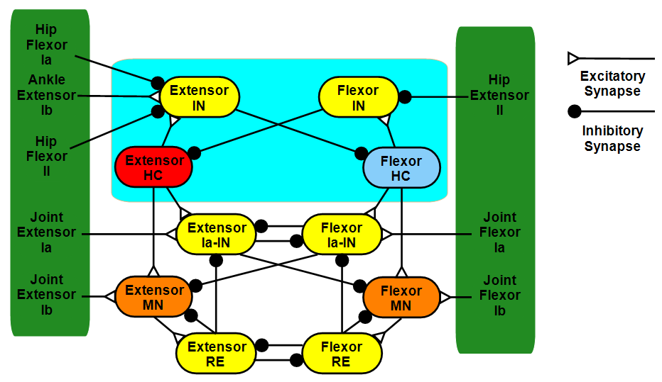
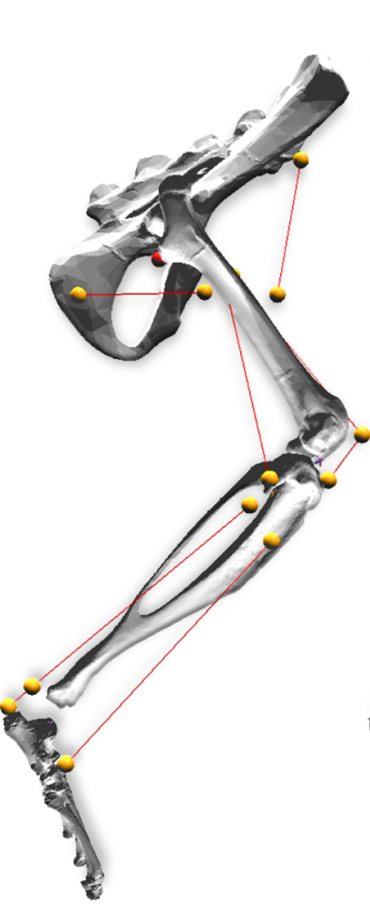
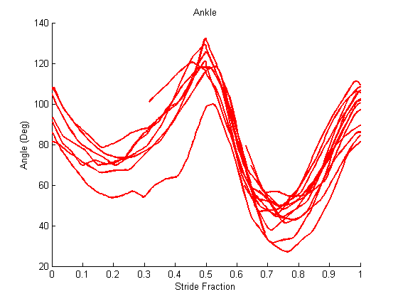
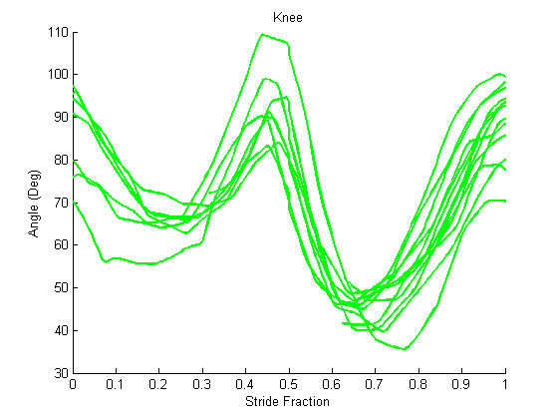
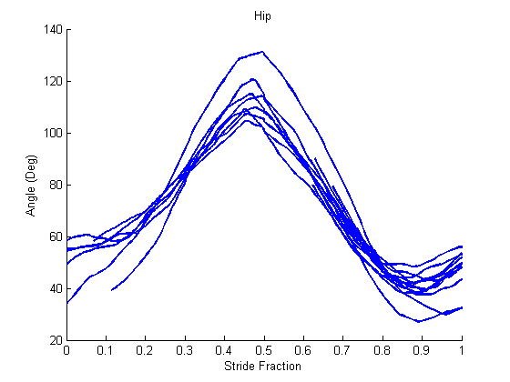
Previous Model
Monoarticular antagonist muscles
Individual joint control
Half-Center CPG
Replicate Walking
Kinematics not match
Can’t reproduce non-resetting deletions

Slide 3
Hypothesis
A more detailed neuromechanical hindlimb model will better matching the walking pattern, reproduce non-resetting pattern and provide better stability.
Specific Aims:
Neurological Controller
Biomechanical Body
Stability Test
Aim 1 – Implementing the hypothesized two-layer CPG into the Synthetic Nervous System of rat hindlimb model. Reproduce the non-resetting deletions observed in rat locomotion.
Aim 2 – Reconstruct the biomechanical model of rat hindlimb, simplify the limb segment complexity and increase the number of muscles in the hindlimb including biarticular muscles.
Aim 3 – Testing the stability of multiple models with different perturbations and which model most accurately captures the animal behavior.

Slide 4
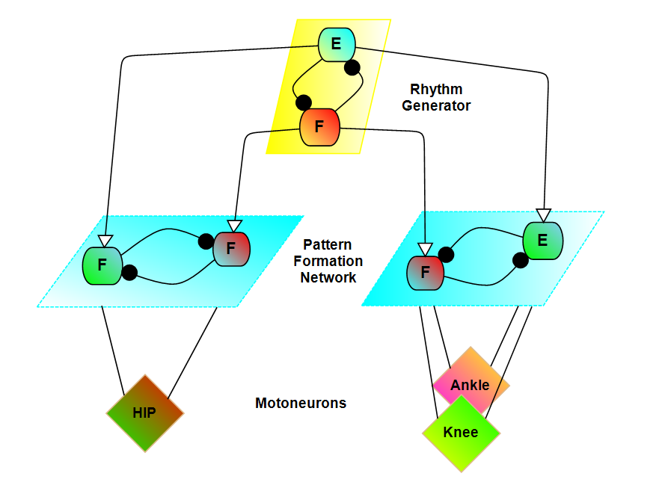
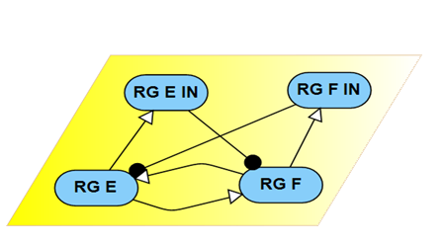
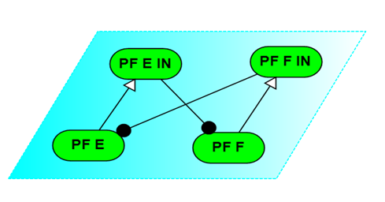
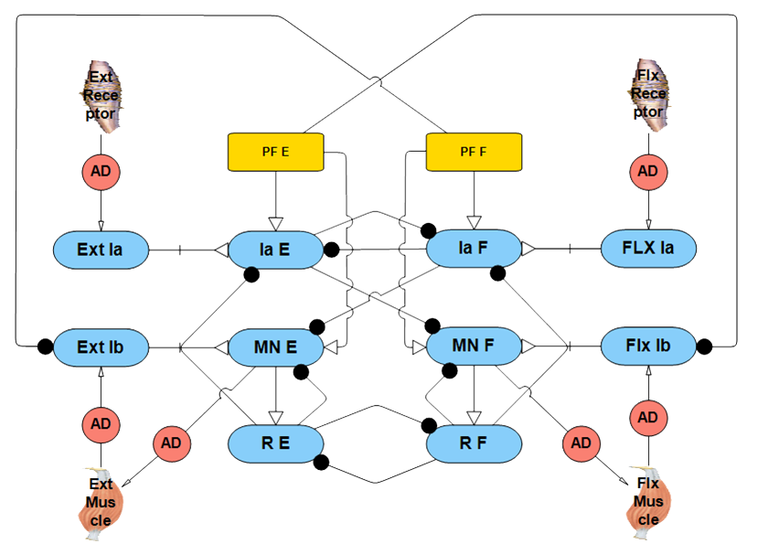
Specific Aim 1
Publications:
Deng, K.; Szczecinski, N.S.; Arnold, D.; Andrada, E.; Fischer, M.; Quinn, R.D.; Hunt, A.J. Neuromechanical Model of Rat Hind Limb Walking with Two Layer CPGs and Muscle Synergies.; Springer International Publishing, 2013; Vol. 8064; ISBN 978-3-642-39801-8.
Deng, K.; Szczecinski, N.S.; Arnold, D.; Andrada, E.; Fischer, M.S.; Quinn, R.D.; Hunt, A.J. Neuromechanical Model of Rat Hindlimb Walking with Two-Layer CPGs. Biomimetics 2019, 4, 21.
With two-layer CPG, the model successfully reproduce the non-resetting deletion observed in rat locomotion.
One rhythm generator each limb to control the walking rhythm.
Pattern formation layer can control single or multiple joint to distribute synergies.
Feedback play important role in stabilizing body, result in slow recovery in non-resetting deletions.

Slide 5
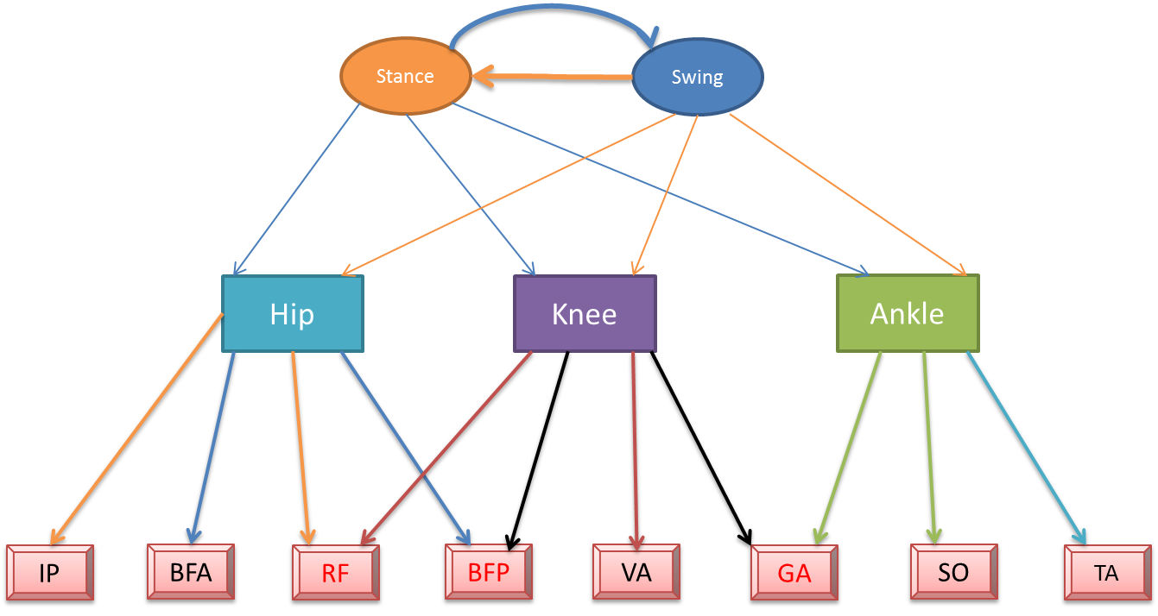
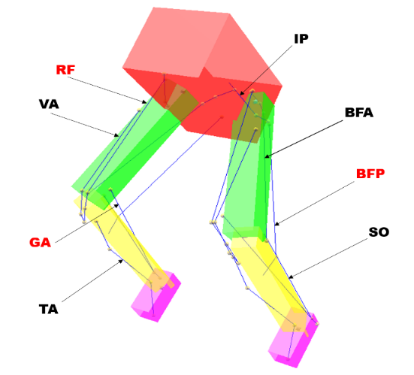
Specific Aim 2
Publications:
K. DENG, A. J. HUNT, R. D. QUINN; Effect of over-actuation on neuromechanical model of rat hindlimb with biarticular muscles. Program No. 762.05. 2019 Neuroscience Meeting Planner. Chicago, IL: Society for Neuroscience, 2019. (Poster present)
Investigate the contribution of Biarticular muscles of rat hindlimb in sagittal walking. (Journal paper in end of this year )
With biarticular muscles, the joint motion is close connected both in neuron network and biomechanical body.
Walking patterns match rat motion better.
Pattern formation layer now distribute synergies by controlling multiple muscles not multiple joints.
Biarticular muscle also distribute perturbation to whole legs to better stabilize the body.

Slide 6
Specific Aim 3
Publications:
Two-layer CPG model
Comparison of multiple models with different perturbation to investigate stability, walking pattern when compare to animal behavior. (future paper)
Implement of two-layer CPG increase the stability of model when internal perturbation occurs.
Increase muscle number and including biarticular muscle make simulation model recover faster from perturbation.
The biarticular muscle model shows better stability when torque applied to limb.
Other models will be developed with to compare with existing model
Biarticular muscle model
Stimulus Perturbation
Torque Perturbation

Slide 7
Conclusion
A more detailed neuromechanical hindlimb model shows better stability and closer approximation of animal behavior as we changing the model.
Future work
Adding more muscles and degrees of freedom to the model with 3D motion data to construct a more realistic rat hindlimb model.
Use the synthetic nervous system as neurological controller for robot, modifying the “puppy” robot for better stability .
Neurological Controller
Biomechanical Body
Stability Test

